Slide 1

Guardians of your code
case : kernel

Slide 2
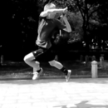
#whoami
Peter Hlavaty, @zer0mem
Senior security researcher at @K33nTeam
Pwn2Own 2015 winner
Wushu player ☺
Speaker :
syscan360 13
zeronigths 13-14
nosuchcon 14
xcon 14
tetcon 15
syscan 15
Bloging :
zer0mem.sk
k33nteam.org/blog
github.com/zer0mem
MiniHypervisor project, DbiFuzz framework, html5 heap spray, …
Developer for cc-shellcoding framework (github.com/k33nteam)

Slide 3
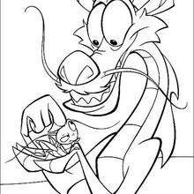
#outline
stack canaries
Pool separation
NonPagedPoolNx
SMEP
(SMAP)
CFG
bug classes
Sal conventions
Boogie
C++ & compiler

Slide 4
What is target of this talk ?
3rd party software becomes more and more attractive attack vectors nowdays
Antivirus software, 3rd party drivers, …
Security awareness of developers should be obligatory!
Vulnerability types
Mitigation mechanisms
Security features
Non-secure software is backdoor for attacker
Easy bugs
Abandoned security features

Slide 5
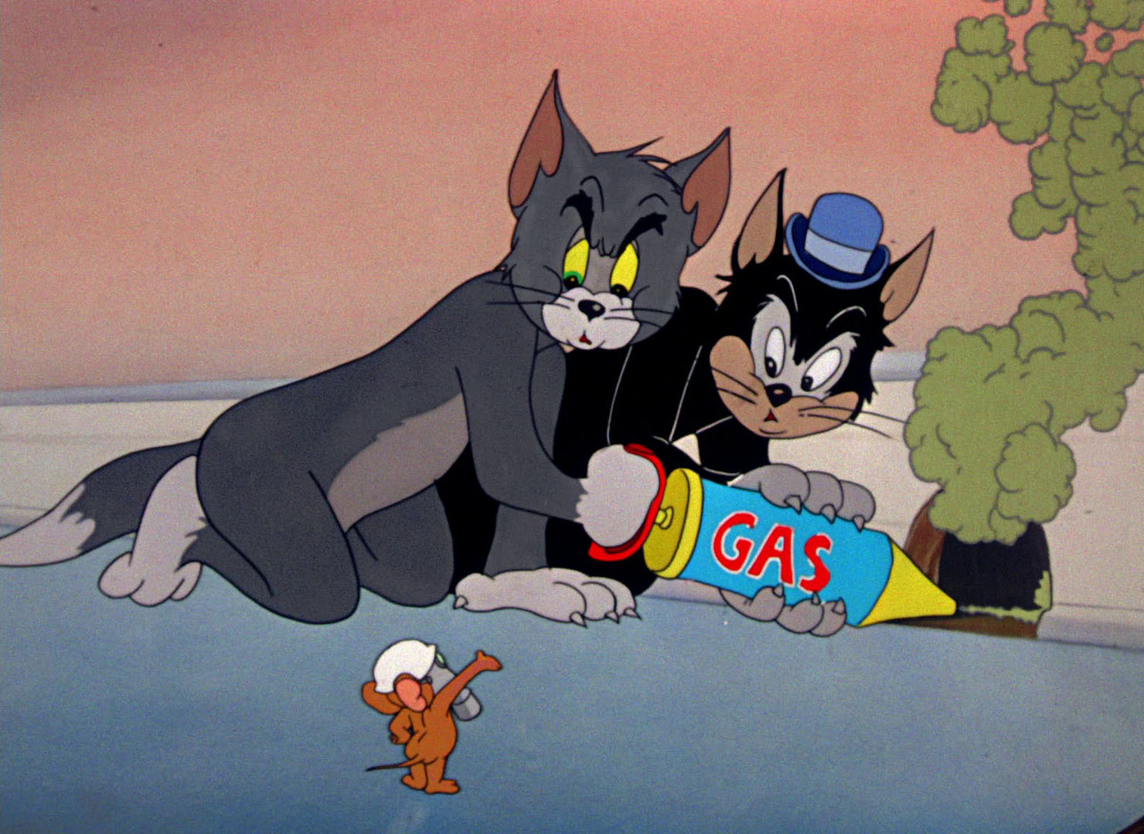
Attacks & Mitigations

Slide 6
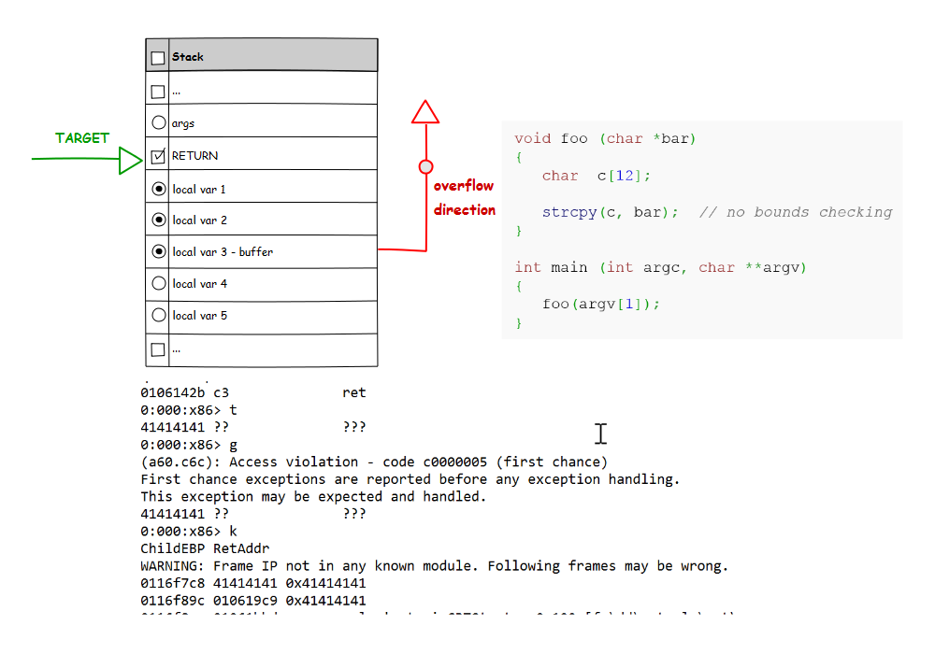
Stack OVERFLOWS
Local buffer on stack
Not sufficient boundary checks
memcpy
Return address pwned
Kernel pwn
http://en.wikipedia.org/wiki/Buffer_overflow_protection
http://en.wikipedia.org/wiki/Stack_buffer_overflow

Slide 7

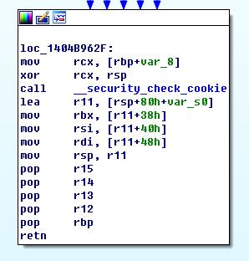
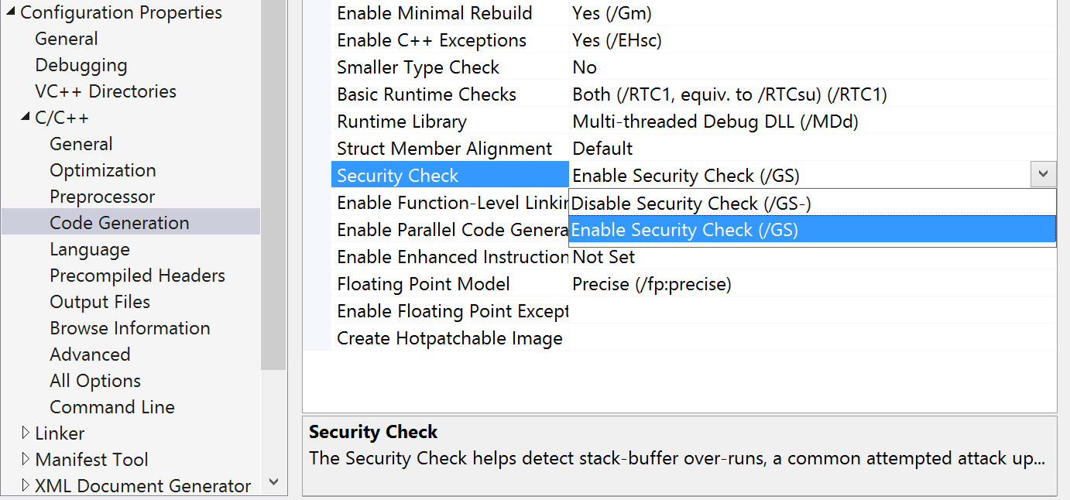
Stack CANARIES
Psuedo-random value placed between local variables & return
Bad memcpy results into rewriting canary
Canary check before using return address
Pwn detected, bsod instead of windows pwn
.. by default ..

Slide 8
Stack canaries
protect
bypass
You can not overwrite return or args without altering canary
You should not be able to guess canary
Means you can not attack stack so easy anymore
Target local vars
Target args by inner non-canary-protected method
Canary leak

Slide 9
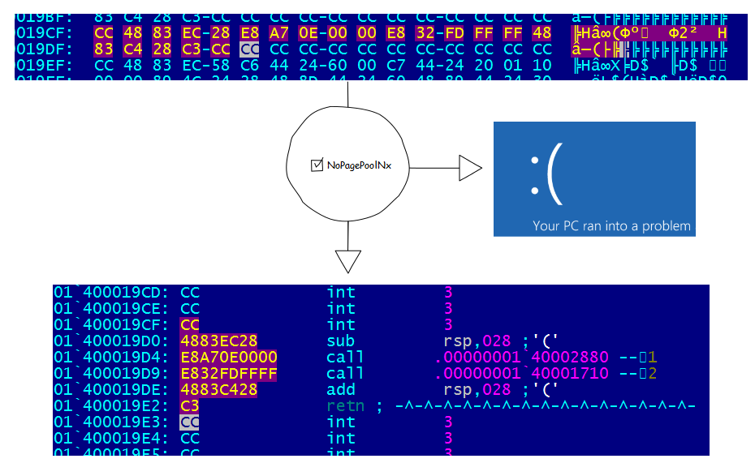
DATA vs CODE
Code is special case of data
If creating data with EXEC
any data shipped from user mode to kernel can be executed
Unless NonPagedPoolNx take place at ExAllocatePool
http://www.hiew.ru/

Slide 10
Data vs Code [NonPagedPoolNx]
protect
bypass
You can not execute data anymore (unless executable – but then should not be data ☺)
Stack is not executable, you have to find another target
Find RWE page
Use ROP
Alter page tables
Force creation RWE page + leak

Slide 11
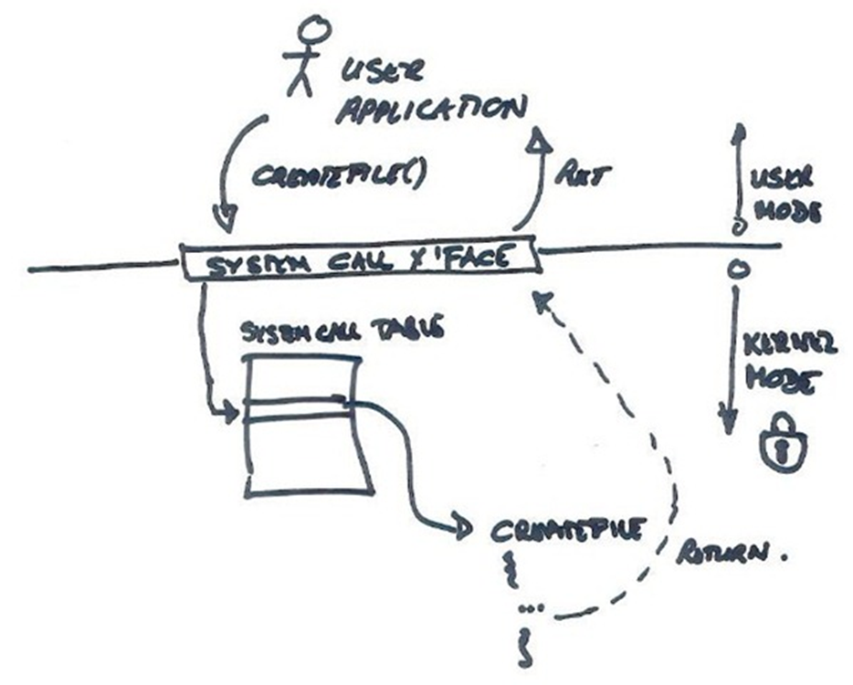
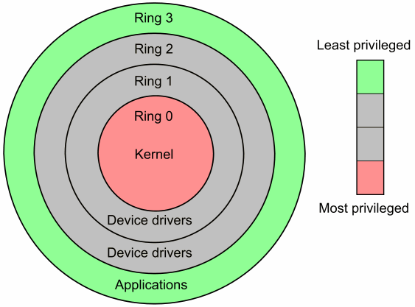
cpl3 vs cpl0
User mode
Kernel mode
Interaction via syscalls
Needed to read passed input
No need to execute user mode code with kernel mode privilages
http://blogs.msdn.com/blogfiles/willy-peter_schaub/windowslivewriter/unisachatteroperatingsystemconceptspart2_875b/system%20call.jpg

Slide 12
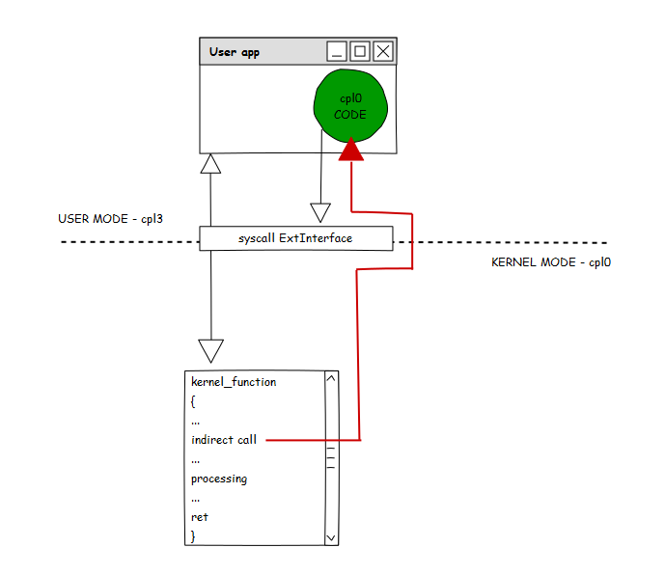
SMEP
X86_CR4_SMEP
Execute user mode code with kernel mode privilages cause BSOD
Previously heavily used as exploitation shortcut

Slide 13
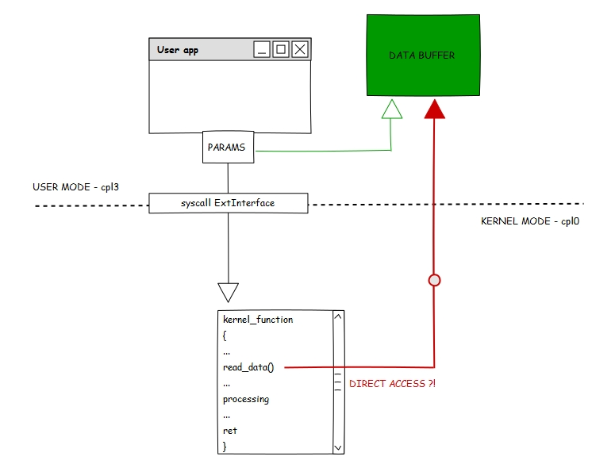
SMAP
X86_CR4_SMAP
In syscall user pass arguments as well
Those arguments have to be readed
No unified method for read / write those inputs is problem for enabling SMAP

Slide 14
cpl0 vs cpl3 [SMEP & SMAP]
protect
bypass
Exec on cpl3 data in supervisor mode will BSOD
Access on cpl3 data in supervisor mode will BSOD as well
In exploitation you have to use only kernel mode data
That means you should to have some sort of info leak
SMAP not enabled on windows yet
ROP or alternatives
Disable features (cr4)
Use pool overflows
Information leaks & controlled data in kernel
Or do not step to kernel, just use RW capabilities
https://software.intel.com/en-us/isa-extensions

Slide 15
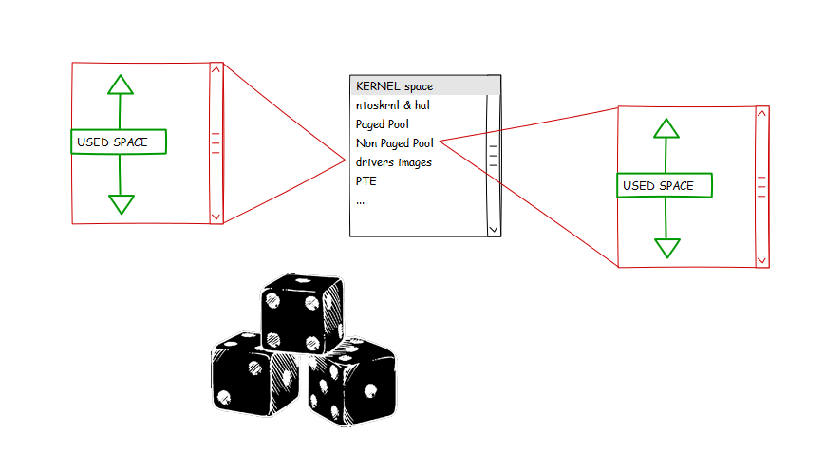
KASLR
Randomization of module addresses
When you do not know where your target is then is hard to attack
Randomization of pool addresses

Slide 16
KASLR
protect
bypass
You can not predict where kernel modules resides
You can not hardcode ROP chain anymore
You are not able to predict base of pools
Info leak
Timing attack
Target pool overflows
Target stack corruption

Slide 17
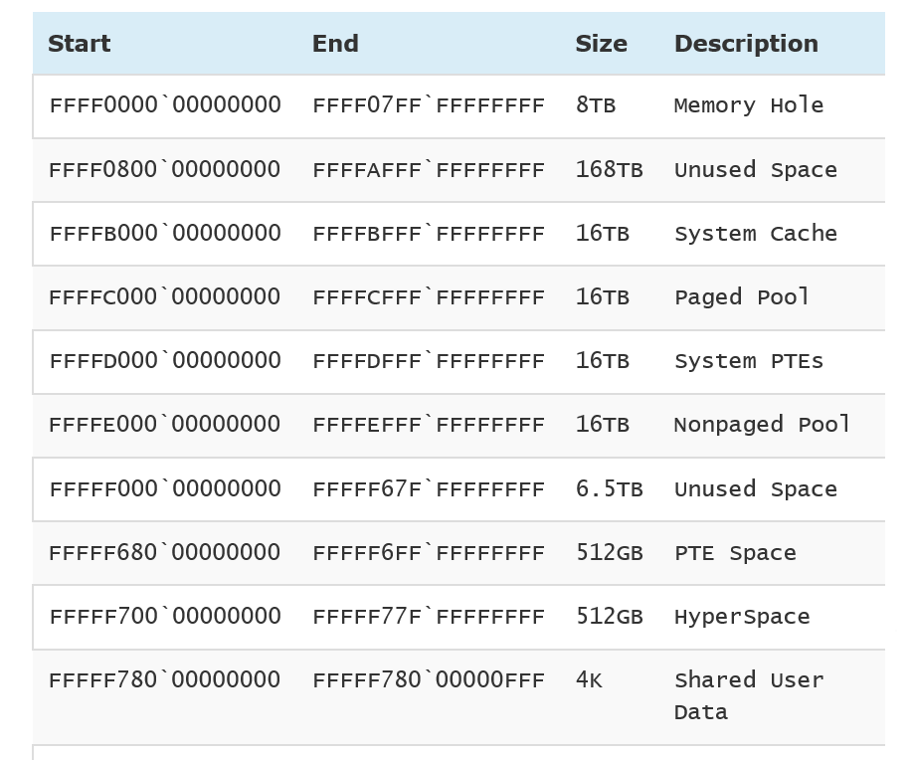
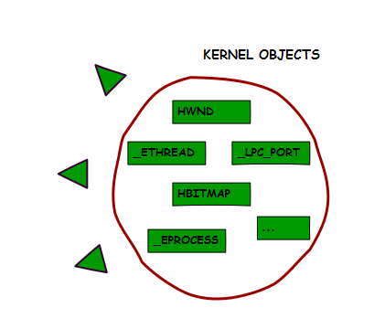
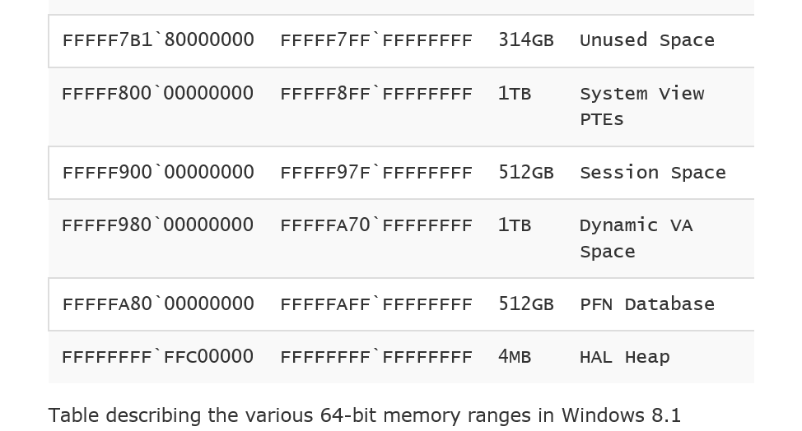
PooL separation & x64 addr space
different pools in kernel address space
Pools are placeholders for different objects
X64 virtual address space > physical space
Can not touch unused virtual space, BSOD otherwise
http://www.alex-ionescu.com/?p=246

Slide 18
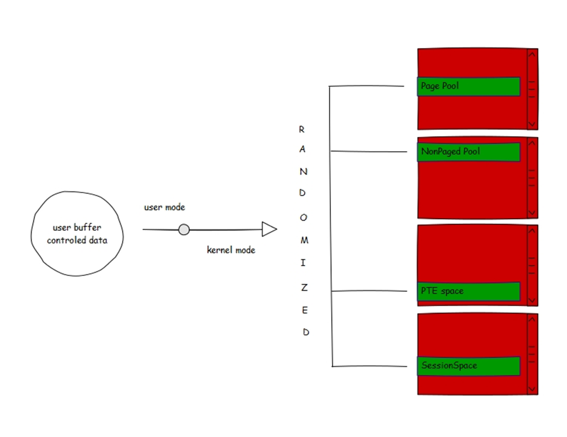
Alloc & Free vs pool managment
Randomized allocs
Big pools not
A lot of times direct control for alloc & free, from user mode
Epic when data : 1 : 1 user : kernel

Slide 19
Pool separation & x64
protect
bypass
Separation of different object – you can not touch object from different pool with pool overflow
x64 address space introduce a lot of gaps (PAGE_NOACCESS), and environment for better usage of KASLR
Pool spray far less effective than before
Leak base of pool & Pool spray
Timing attacks & pool spray
Pool overflow
Object, on the pool, address leak
Pool layout

Slide 20
UAF & vtable
Freed object A
But someone is still hold reference to object A
Meanwhile changed state – another object (/ data) take freed objects A place
Many objects contains pointers – especially *function pointers*
Object A used afterwards

Slide 21
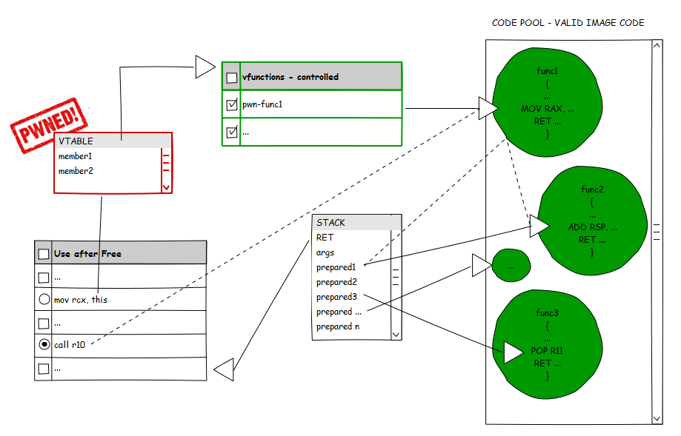
ROP overview
Attacker thinks at assembly level
Reuse of existing code
Need to setup right context
stack & registers & memory
Many code reused
Need to find good pieces of code

Slide 22
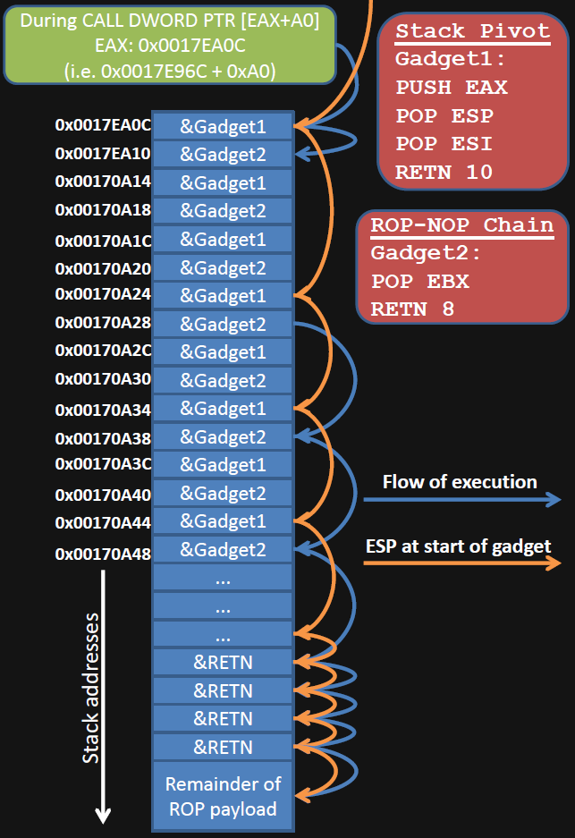
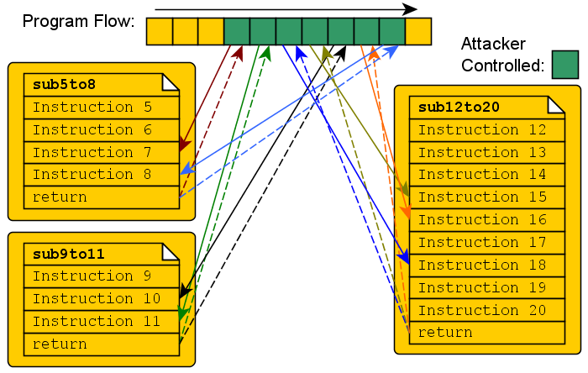
Used for bypassing non-exec stack
Widely used nowdays
http://seclists.org/bugtraq/1997/Aug/63

Slide 23
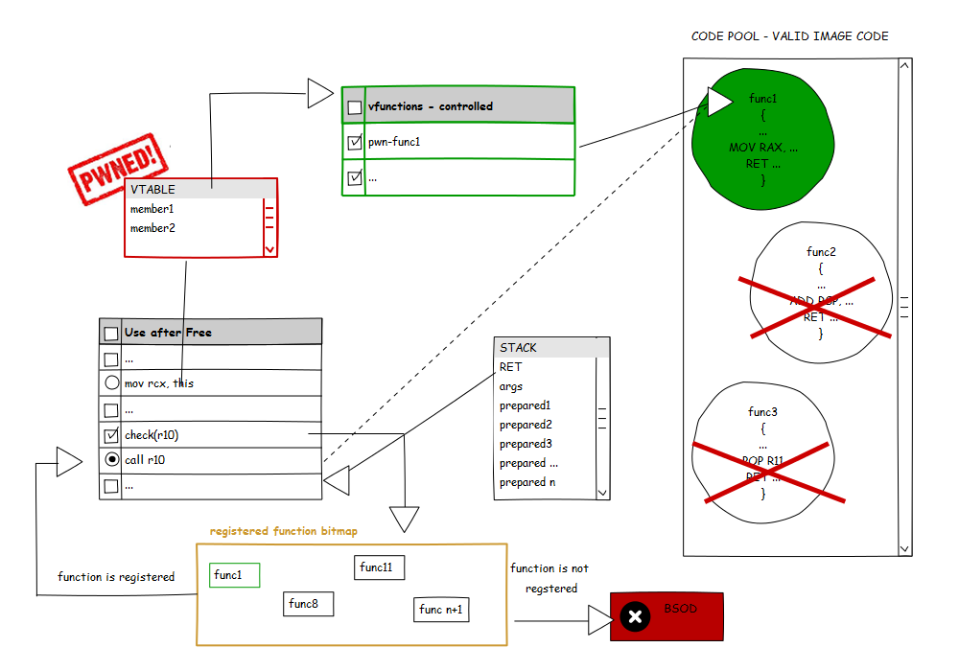
CFG overview

Slide 24
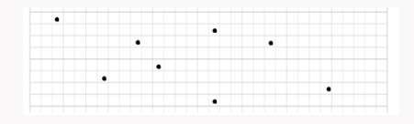
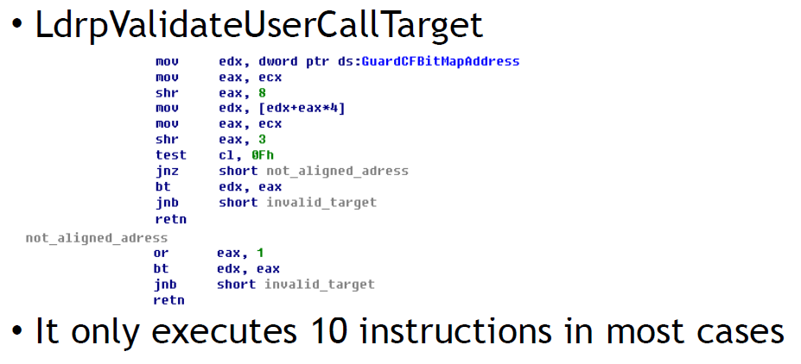
ROP vs CFG
>> Implementation
Indirect calls check
in kernel mode not so widely used anyway .. yet, unfortunately …
bitmap & registered functions
http://blog.trendmicro.com/trendlabs-security-intelligence/exploring-control-flow-guard-in-windows-10/
http://www.powerofcommunity.net/ poc2014/mj0011.pdf

Slide 25
CFG [user mode mainly]
protect
bypass
Protect virtual calls (and some others) against direct ROP technique
You have to use valid function, in f.e. UAF bug
regular functions driven attack
Stack pivoting
Stack hooking

Slide 26

Review

Slide 27
Guardians of your code
auto
Code &/ Compiler
Pools
SMEP
KASLR
Stack canaries
NonPagedPoolNx
SMAP
cfg
Even when mitigation in place, treat every bug as exploitable! Every mitigation has its own weak point! Maybe we do not know how to exploit it now, but someone else might know …

Slide 28
Why so many hardening ?
We are humans and making mistakes
Many bugs in code, especially in large codebase
OS introduce many defensive mechanism for effectively mitigating techniques for exploiting bugs
But every mitigation has its own limitation
Biggest limitation is bug & developer itself
Every developer should be aware of software security problems :
mitigation techniques, vulnerability classes, auditing tools, security features

Slide 29
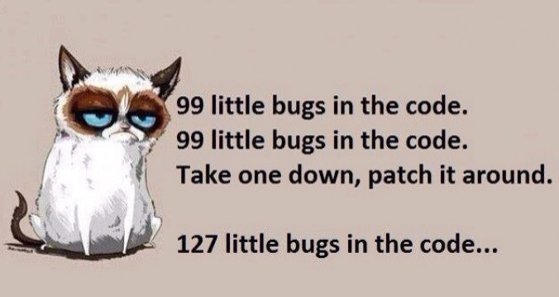

Slide 30
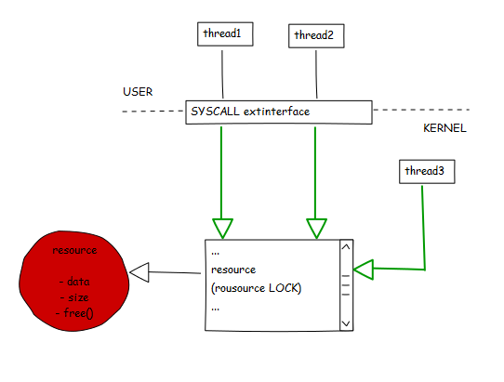
RACE conditions
Shared resource
Multiple thread access at same time
out-of-lock access
Convertable to another vulnerability class!
Easy to make this bug
Hard to avoid
www.slideshare.net/PeterHlavaty/ racing-withdroids

Slide 31
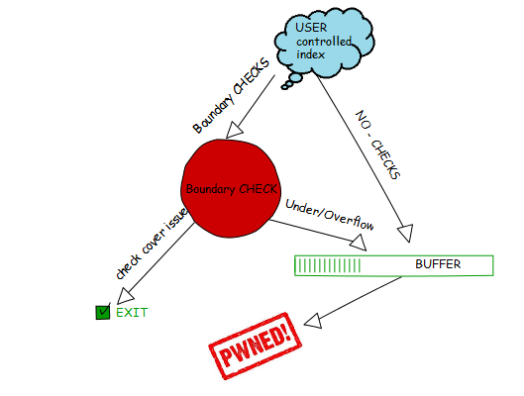
Out of Boundary
Insufficient boundary checks, or not present at all
Integer over/under flows in boundary check
Arbitrary read / write for attacker
www.slideshare.net/PeterHlavaty/ attack-on-the-core

Slide 32
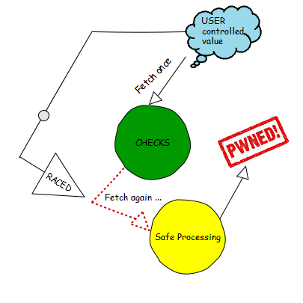
TOCTOU
In syscall is provided pointer to user mode memory
This memory is first checked and pass by kernel
Another user / kernel thread change memory at that pointer
Kernel accessing changed memory
j00ru.vexillium.org/?p=1695

Slide 33
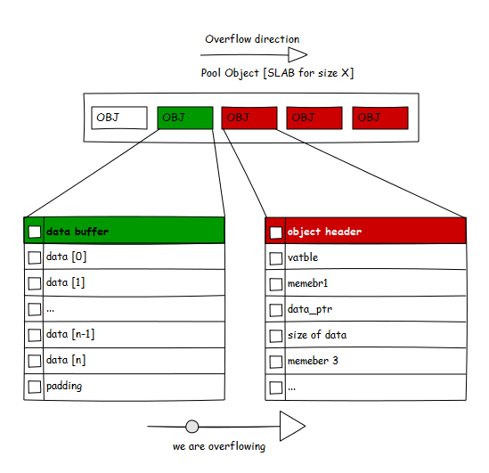
Buffer overflows
One of the most common vulnerability class
One of the most powerful
Can break { SMEP & SMAP & KASLR } by nature – ofc not every overflow
http://confidence.org.pl/en/agenda/lecture/when-something-overflowing/

Slide 34
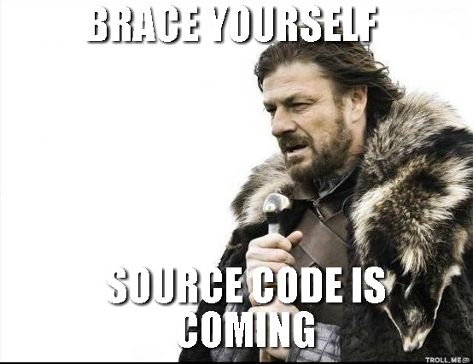
.. coding on the move ..

Slide 35
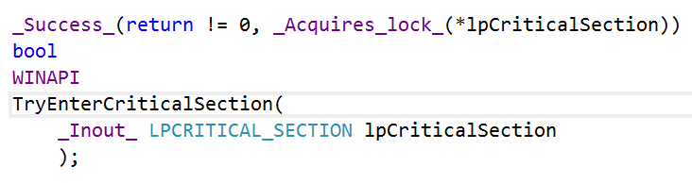
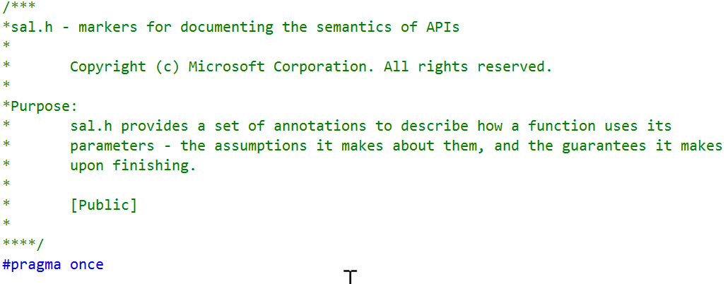
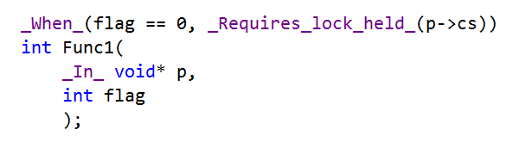
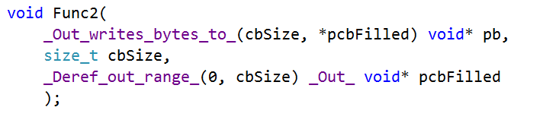
Use SAL
Specify arguments
Boost static checks!
Avoid *ANY* warning!
Can detect a lot! { uninitialized, overflows, out-of-bounds, nulls, .. }
https://msdn.microsoft.com/en-us/library/ms182032.aspx
https://technet.microsoft.com/zh-cn/subscriptions/
ms235402(v=vs.100).aspx

Slide 36
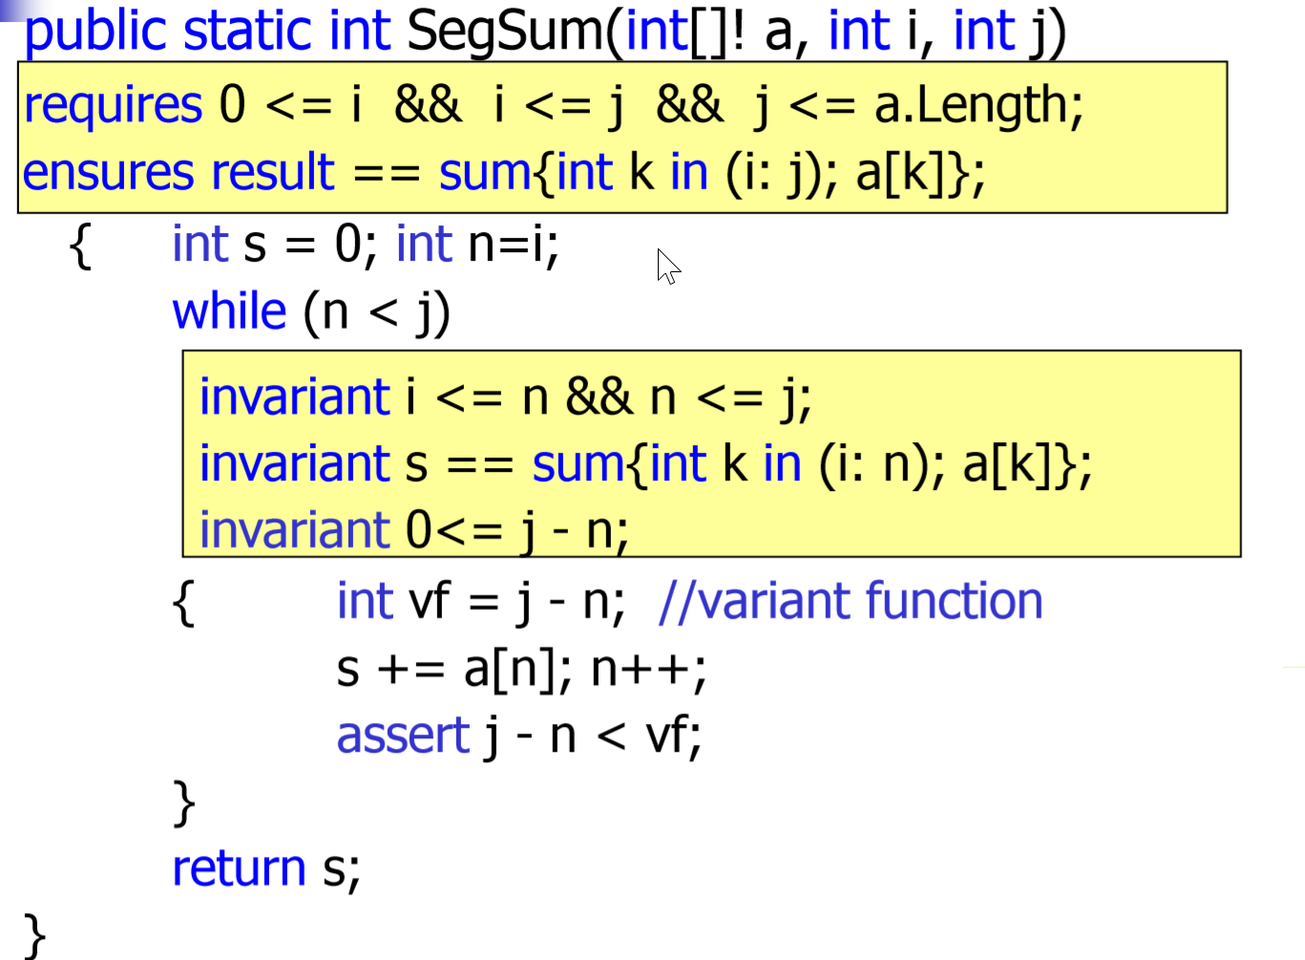
BOOGIE
Verification language
C# (C)
Way to go!
Use boogie or Develop your own VL ?
C++ ?
http://research.microsoft.com/en-us/projects/boogie/

Slide 37
C++ on the rise
Compiler can be your best friend
Language is continuously evolving
C++11
common libraries: boost & stl
Even windows kernel itself is moving (+-) towards c++
Effective & clean architecture
Maintaining large code base ++
Make use of design patterns
Rethink every time, but it does not mean to use them every time as well…

Slide 38
What every programmer should know
C++ :
http://www.bogotobogo.com/cplusplus/multithreaded4_cplusplus11.php
http://simhttp://www.bogotobogo.com/cplusplus/multithreaded4_cplusplus11.phppleprogrammer.com/2012/12/01/why-c-is-not-back/ (another point of view, good to read)
design patterns :
https://sourcemaking.com/design_patterns
programmers :
http://neilscomputerblog.blogspot.gr/2014/06/destroying-rop-gadgets-with-inline-code.html?spref=tw
http://danluu.com/new-cpu-features/
http://blog.llvm.org/2011/05/what-every-c-programmer-should-know.html?m=1
http://www.akkadia.org/drepper/cpumemory.pdf
http://stackoverflow.com/questions/2794016/what-should-every-programmer-know-about-security
Boogie :
http://www.rosemarymonahan.com/specsharp/papers/SBMF2010.pdf
http://www.zvonimir.info/2010/12/a-tutorial-for-running-boogie-and-z3-on-linux/
http://www4.in.tum.de/~boehmes/hol-boogie-tphols-talk.pdf
http://webcourse.cs.technion.ac.il/236800/Winter2010-2011/ho/WCFiles/Boogie.pdf

Slide 39
auditing
In company reviews
First make design & measure, then optimize
Do multiple reviews of design & production code
In company audits & fuzzing
Unit testing
White-box fuzzing
Audit companies & consulting
Let security guys to pinpoint problems which you could likely to overlook
Bug bounties
Let more people boost security of your product

Slide 40

@K33nTeam
Thank You!
Q & A
We are hiring!
Kernel & app sec
A LOT of research
mobile, pc
M$, android, OSX ..

Slide 41

PENCIL
http://pencil.evolus.vn/
SPEICAL THANKS TO SKETCHES I was able to made ☺

